Slide 1
Component 2
I designed the Graph Retrieval Layer using 3 python files and then validated and demonstrated the full pipeline in a Jupyter notebook
1) Graph_Retriever.py
Acts as the main controller
Routes requests based on intent
Combines baseline and embedding-based retrieval
2) Baseline_Retriever.py
Contains all Cypher query templates
Handles exact graph queries
3) Embedding_Retriever.py
Handles Node2Vec and GraphSAGE training
Stores embeddings on nodes
Performs vector similarity search in Neo4j

Slide 2
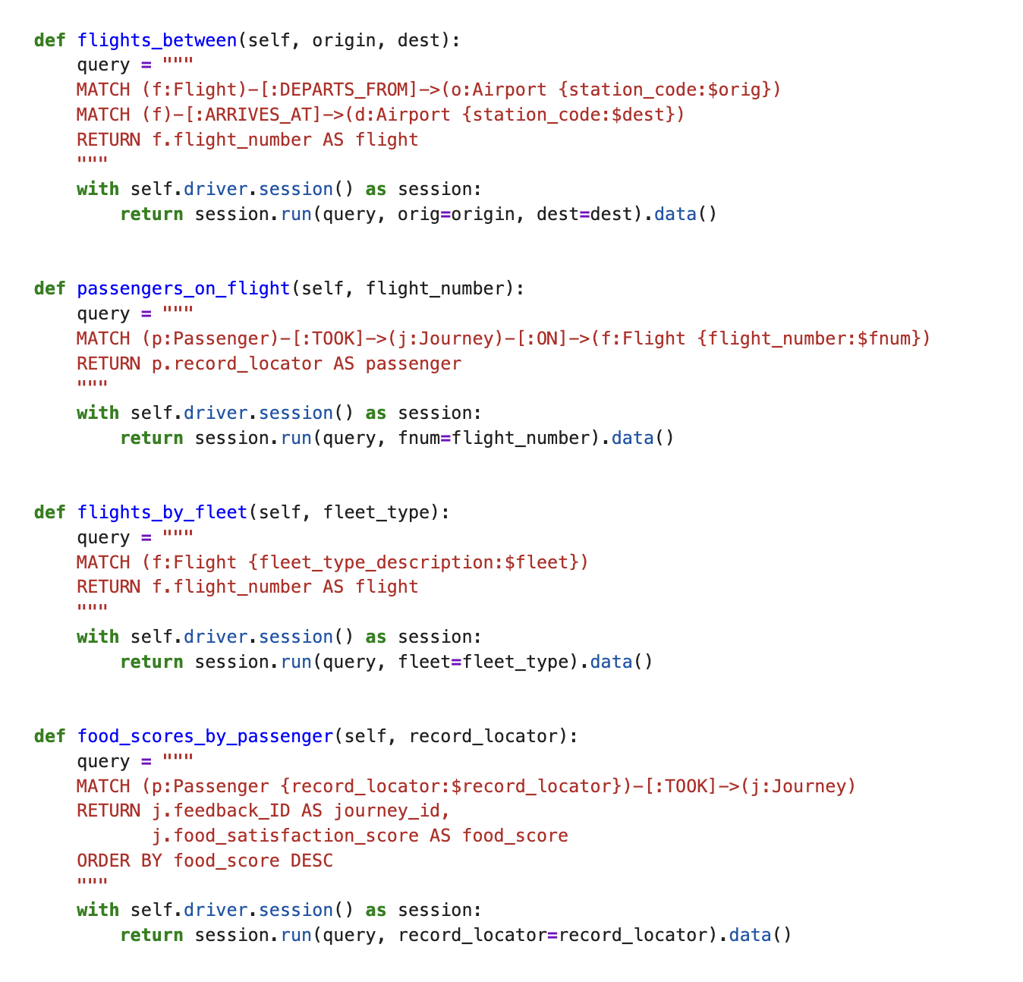
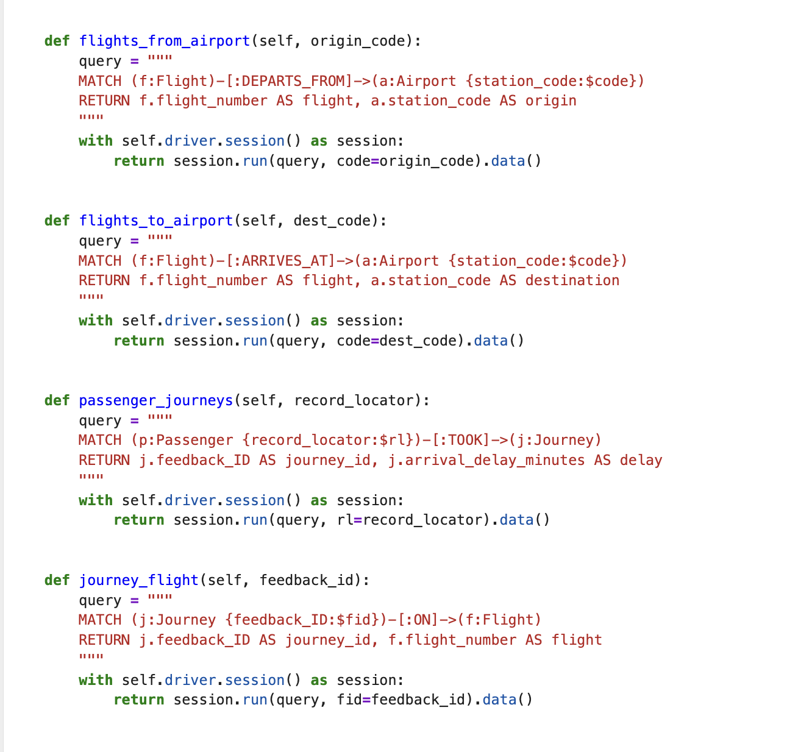
In the baseline retrieval I implemented more than ten baseline Cypher queries to retrieve structured graph information.

Slide 3
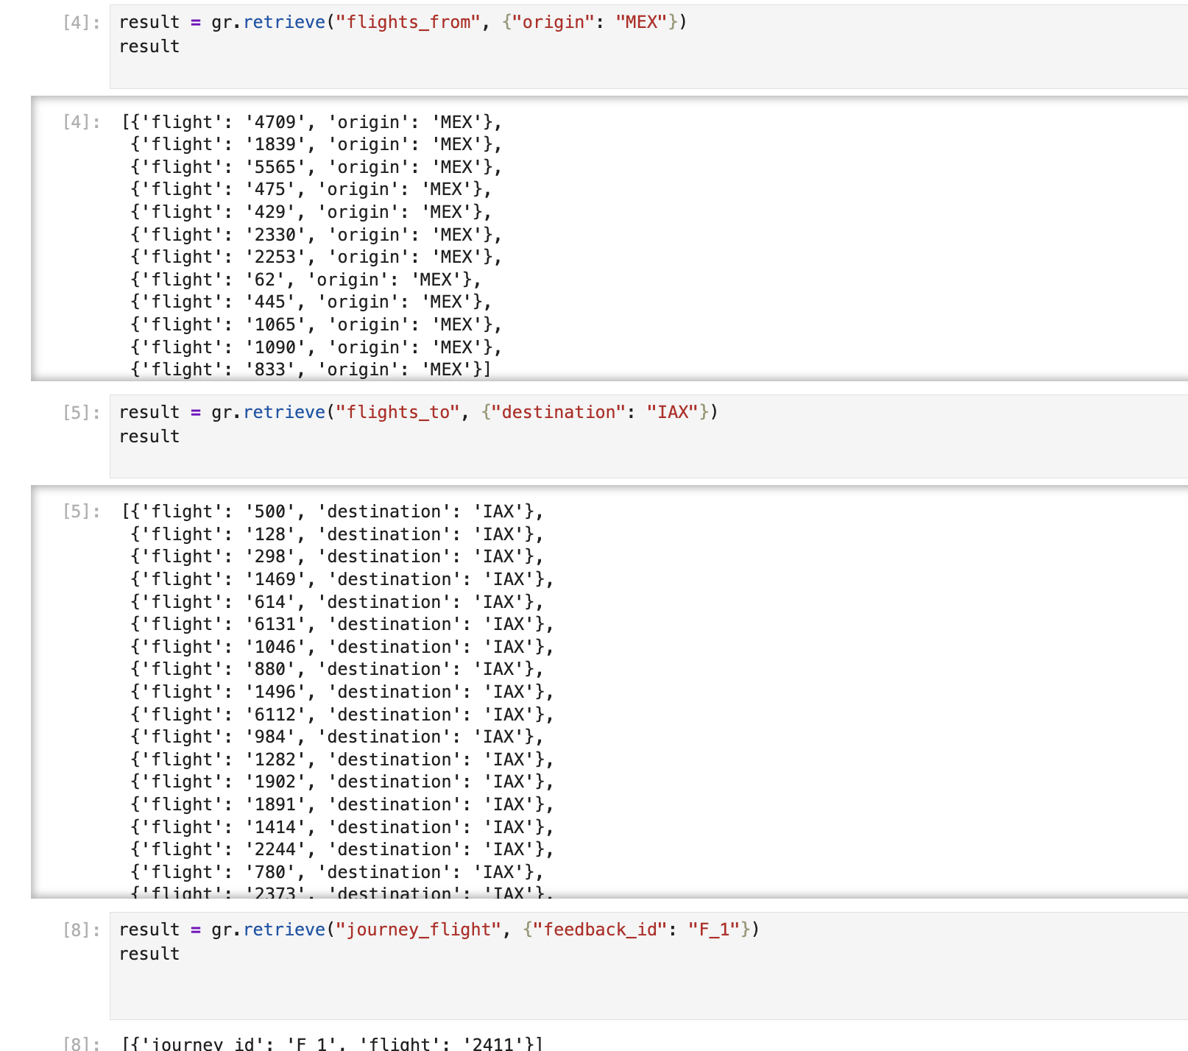
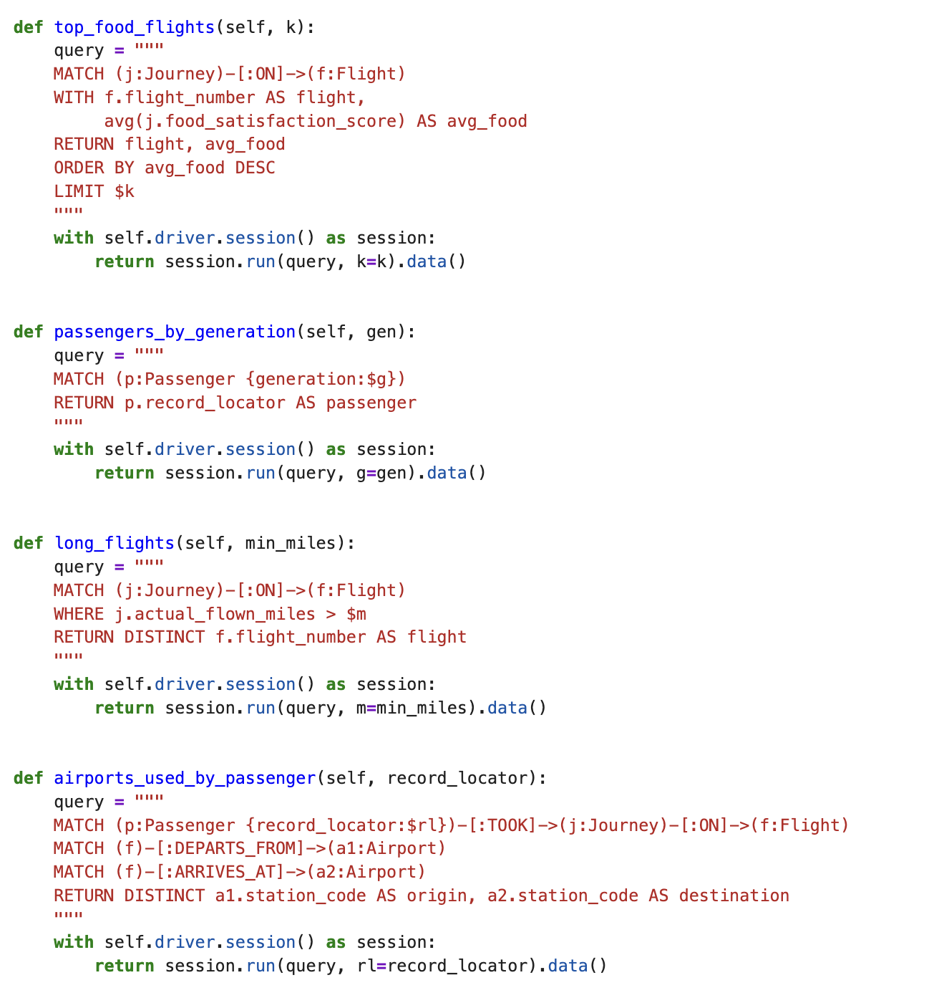

Slide 4
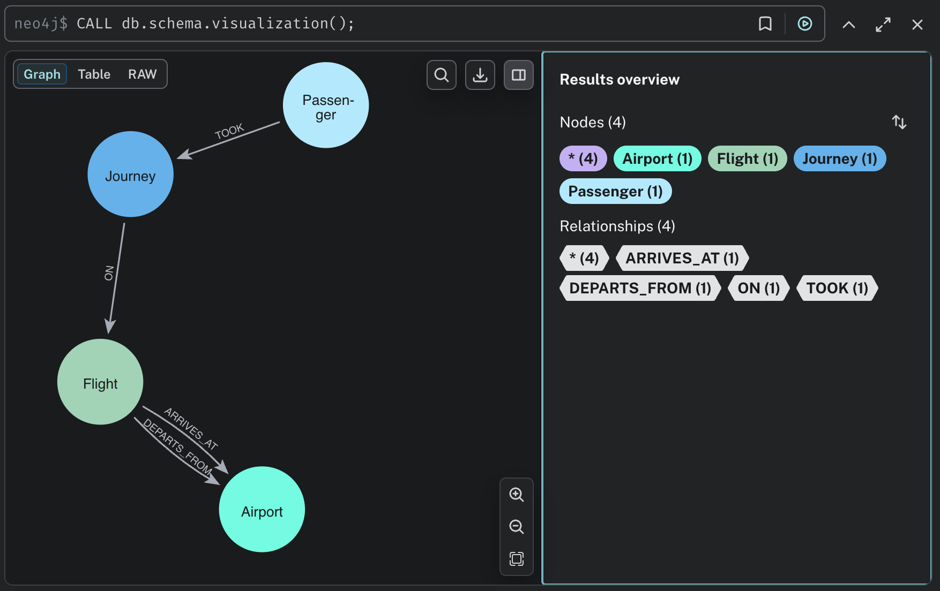
Knowledge Graph Schema
Nodes: Passenger, Journey, Flight, Airport
• Relationships: TOOK, ON, DEPARTS_FROM, ARRIVES_AT

Slide 5
After baseline retrieval, I added an embedding-based retrieval layer
using Node Embeddings
I chose Node Embeddings because our data is naturally represented
as a graph, and the goal is to capture structural and relational
similarity between entities
I implemented two models :
1) Node2Vec
Captures structural similarity through random walks
2) GraphSAGE
Captures neighborhood semantics using neural aggregation
I trained both models and compared their similarity outputs to
analyze how different embedding strategies behave on the same graph.

Slide 6
The Jupyter notebook is used to execute, validate, and demonstrate the full retrieval pipeline.
1) Connection to Neo4j
2) Baseline query execution
  Running Cypher queries
  Displaying returned nodes and relationships
3) Embedding training
  Training Node2Vec
  Training GraphSAGE
  Storing embeddings back into Neo4j
4) Vector similarity search
  Querying similar nodes
  Comparing Node2Vec vs GraphSAGE results

Slide 7
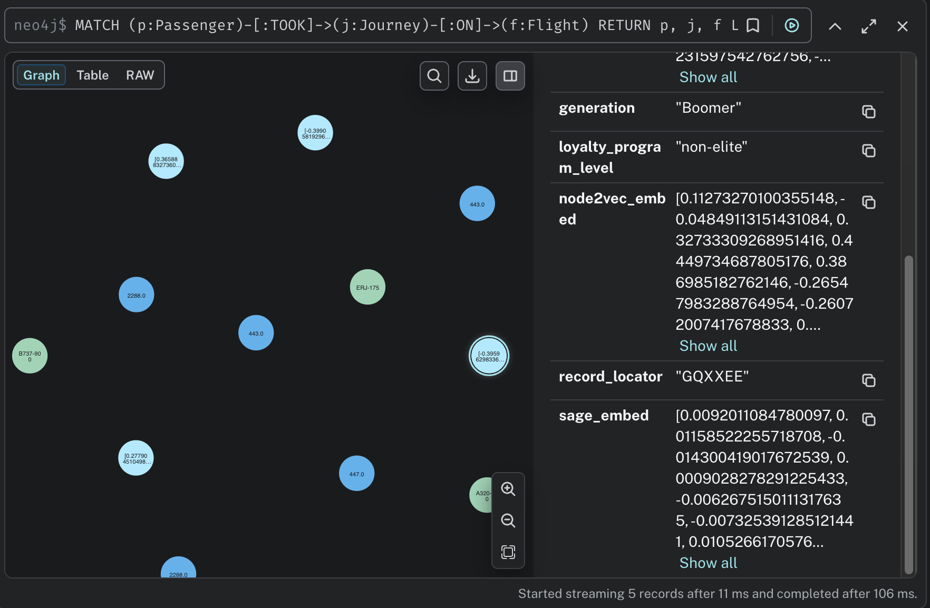
After training both models
Each node is enriched with a learned vector representation capturing its structural context.

Slide 8
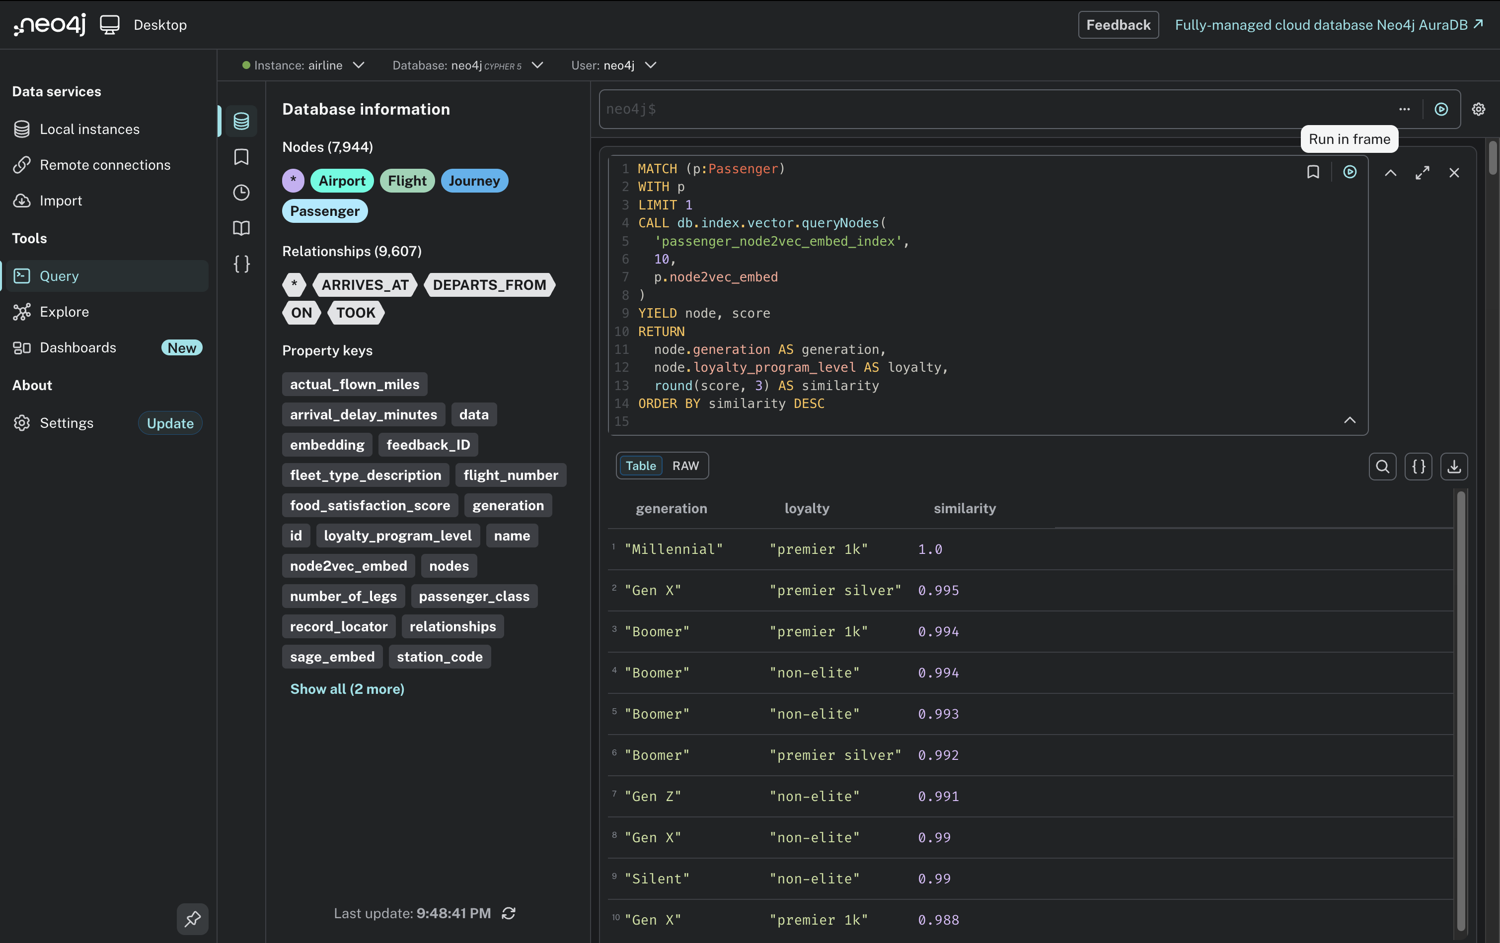
Node2Vec similarity search

Slide 9
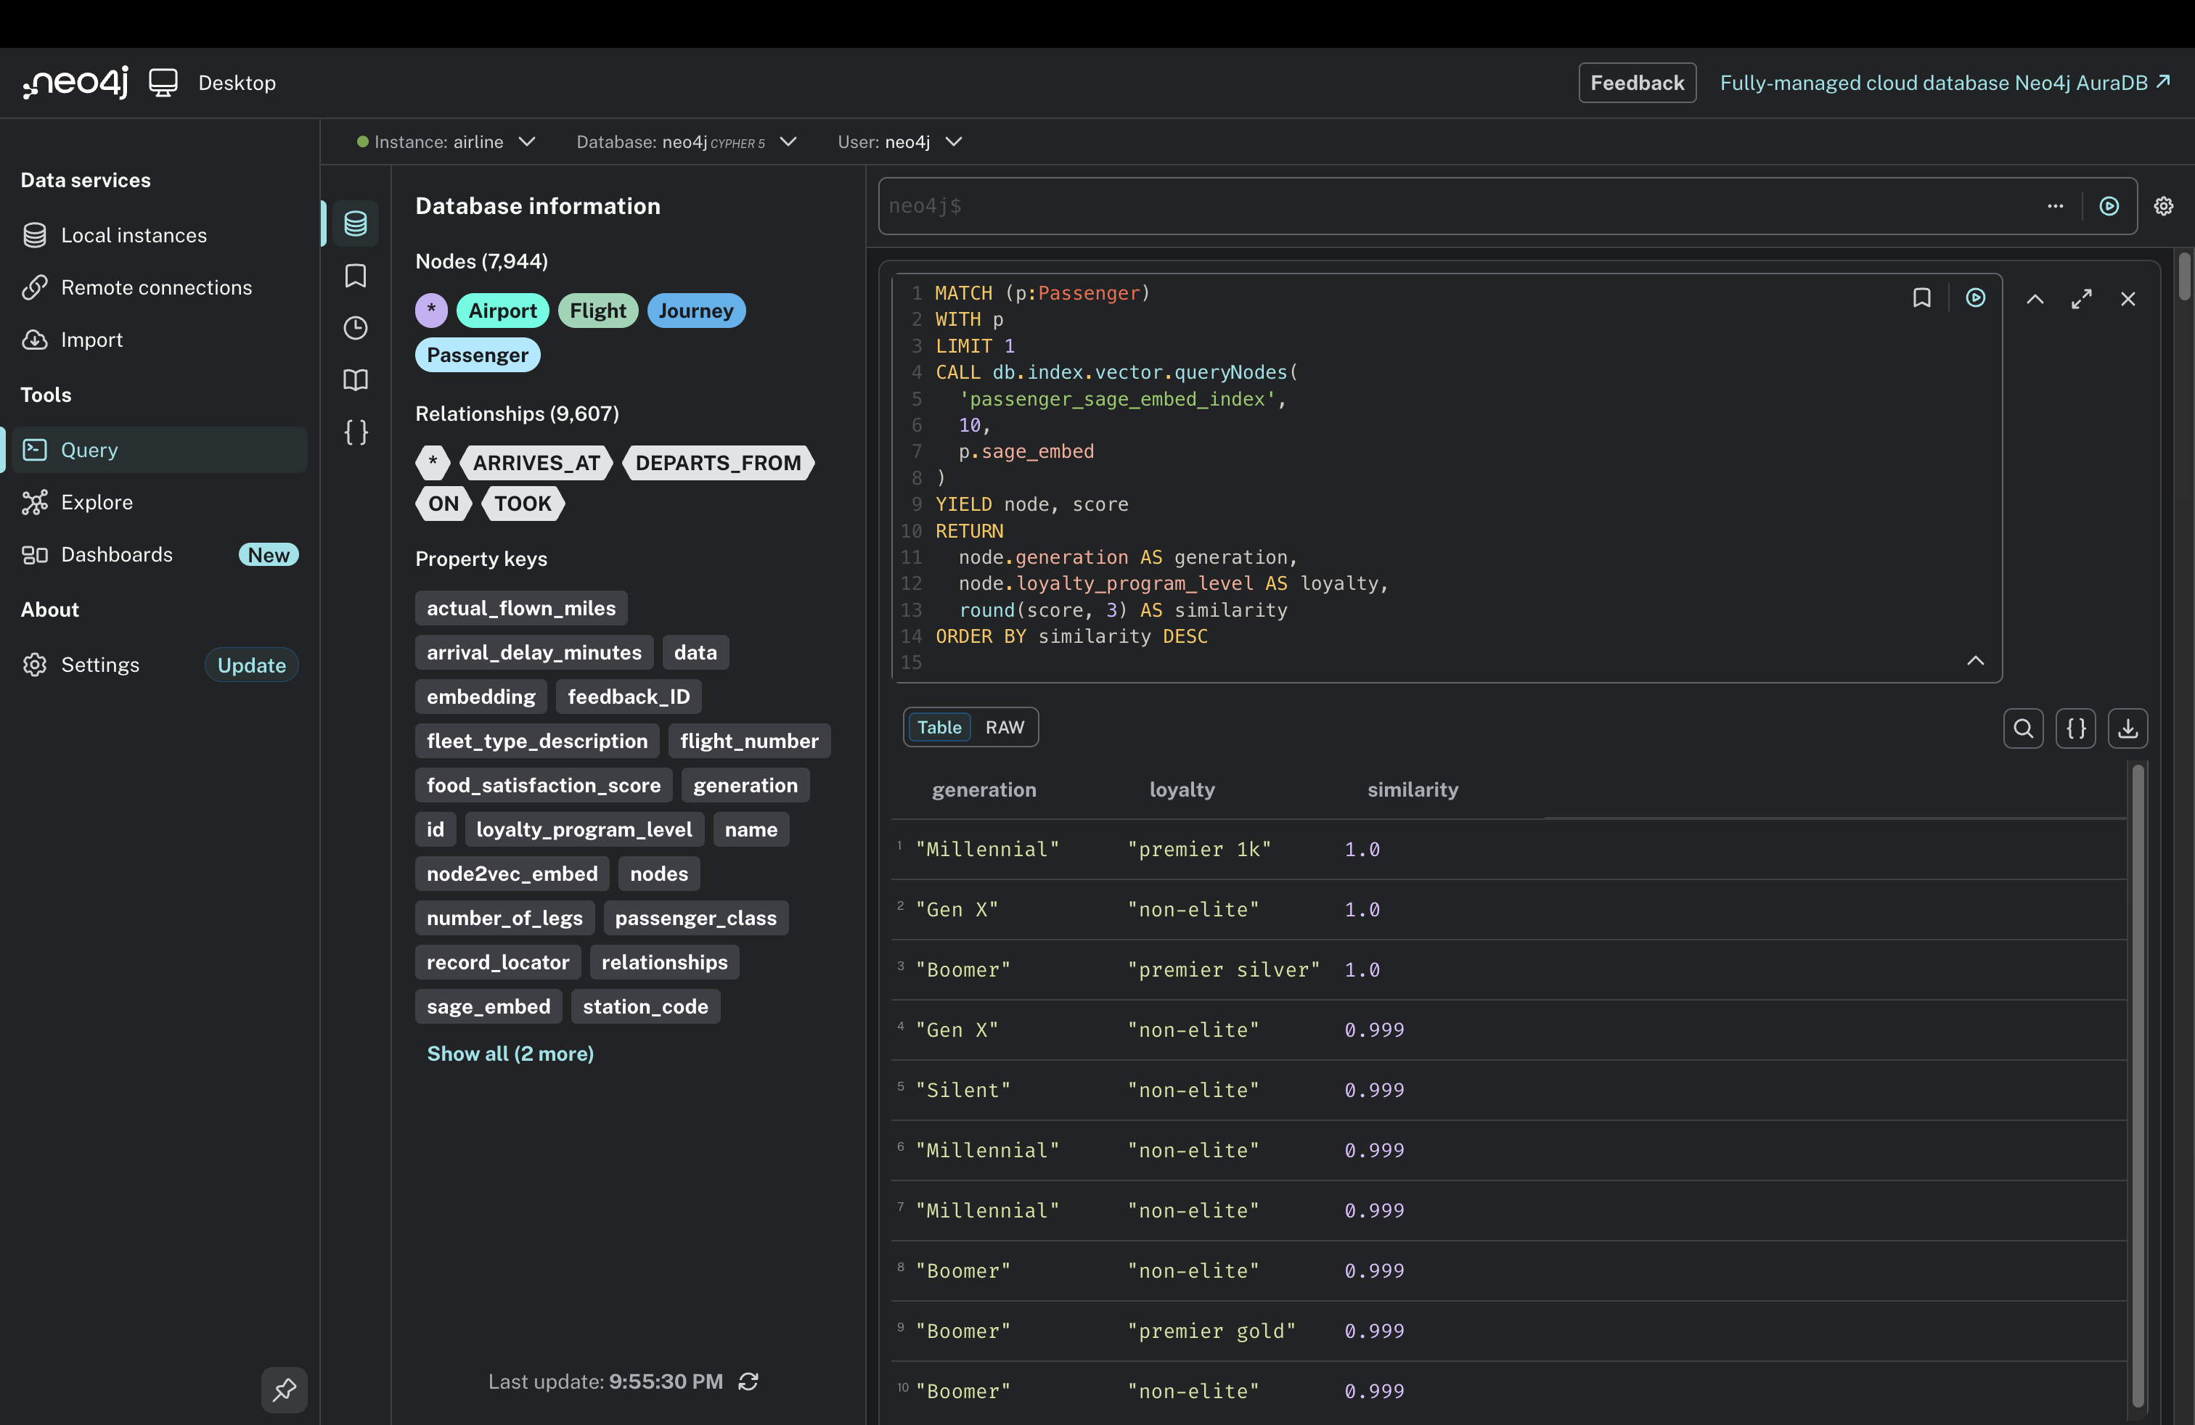
GraphSAGE similarity search

Slide 10
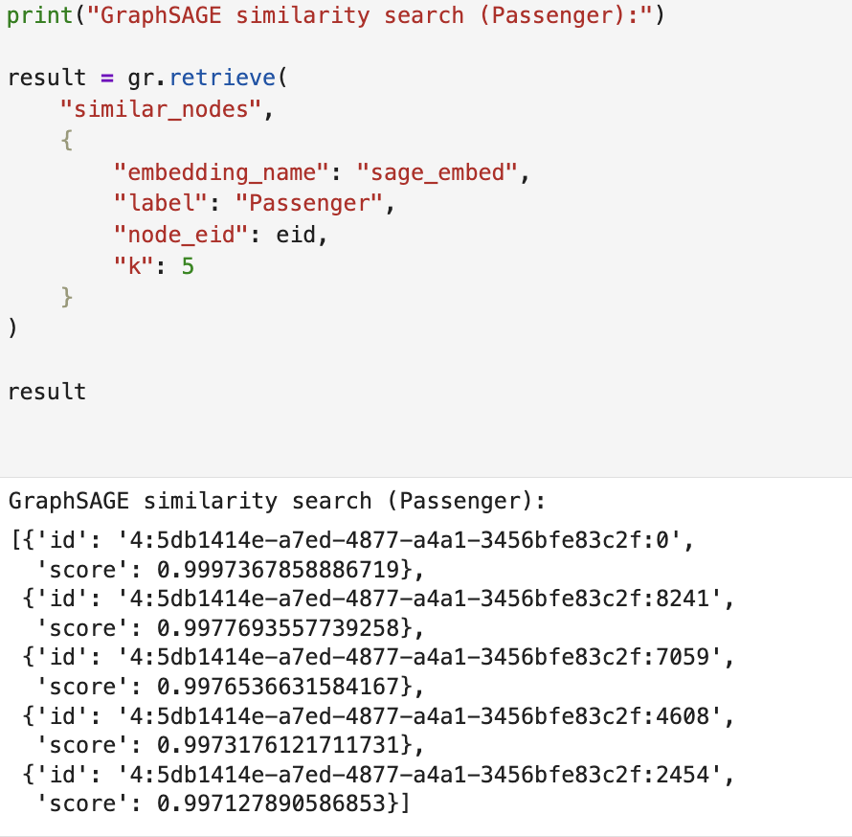
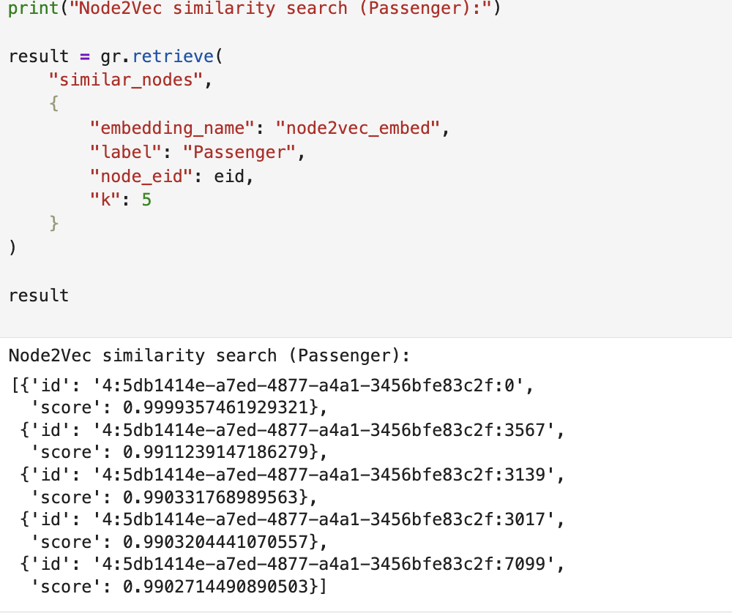
And these are their outputs from the notebook

Slide 11
Component 3
•⁠ ⁠Input received from preprocessing layer (intent + entities)
•⁠ ⁠Baseline Cypher query results retrieved from KG
•⁠ ⁠Embedding-based retrieval results
•⁠ ⁠Merge function combines both sources
•⁠ ⁠Duplicate flights removed
•⁠ ⁠Unified context prepared for LLM input

Slide 12
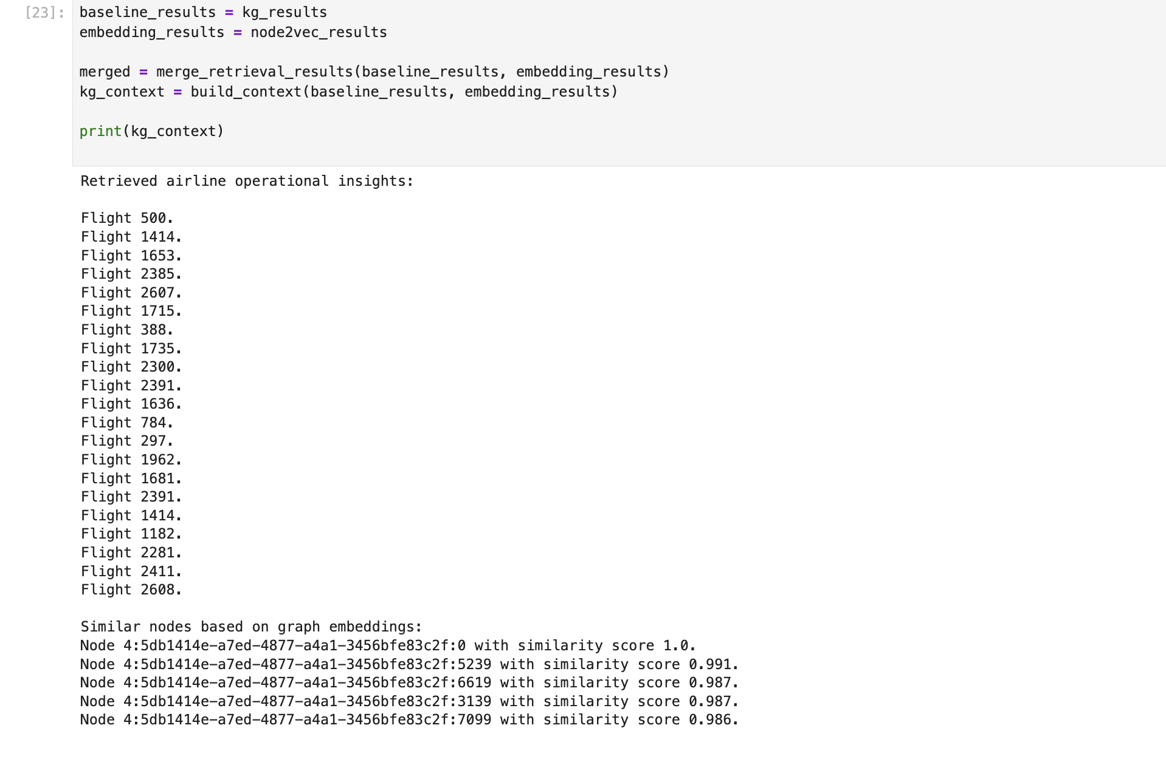

Slide 13
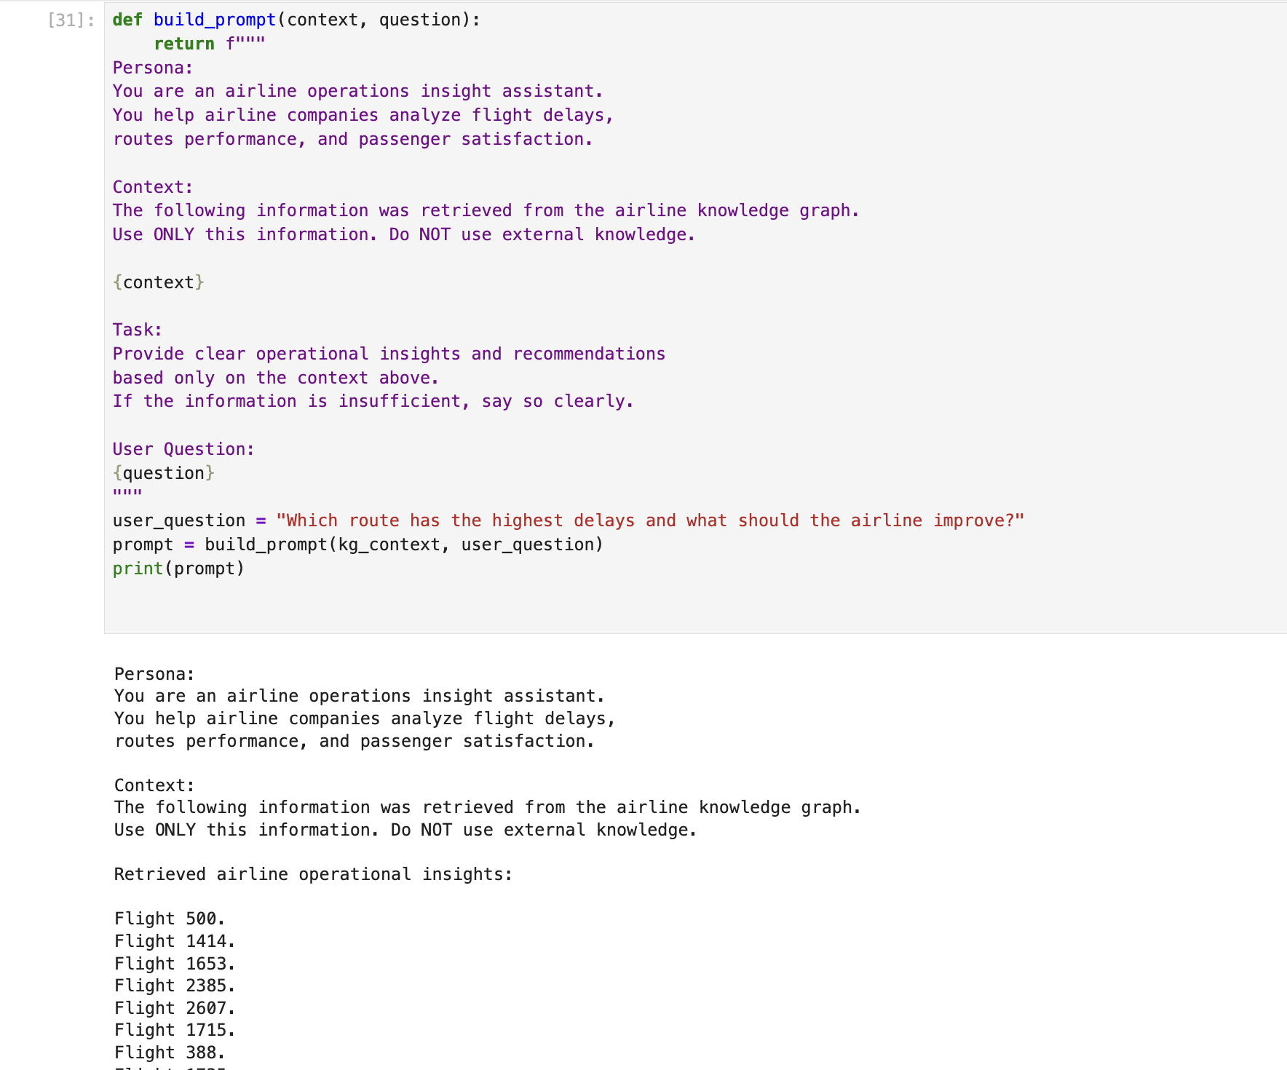
•⁠ ⁠Persona defines the assistant role as a flight information assistant
•⁠ ⁠Context contains only merged KG and embedding results
•⁠ ⁠Task instructs the model to answer using provided context only
•⁠ ⁠Same prompt structure used across all models

Slide 14
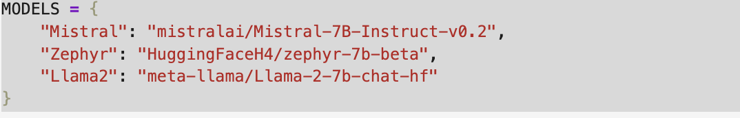
Same merged KG context used for all models
•⁠ ⁠Same structured prompt applied across models
•⁠ ⁠Multiple open-source LLMs selected for comparison
•⁠ ⁠Quantitative metric: response latency
•⁠ ⁠Qualitative evaluation: relevance and correctness
•⁠ ⁠Large models require extended inference time in notebook environment

